Slide 1

Chaotic Dynamics of Stellar Spin in Binaries and the Production of Misaligned Hot Jupiters
Natalia Storch, Kassandra Anderson & Dong Lai
Cornell University

Slide 2
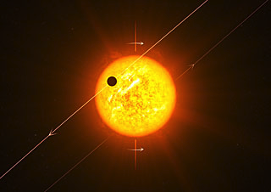
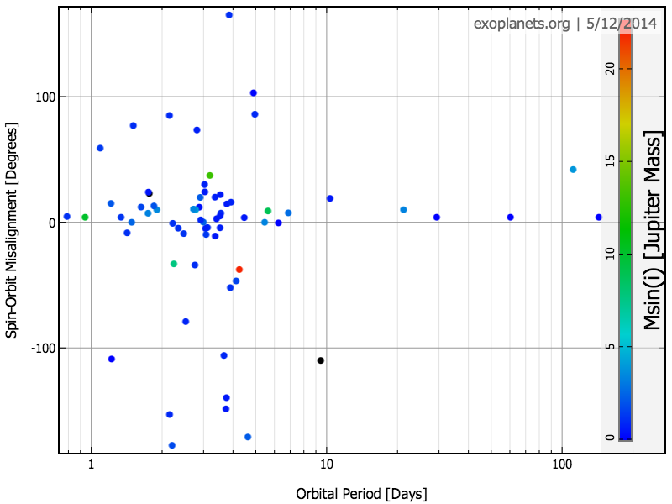
Many hot Jupiter systems have been found to exhibit misalignment between the
orbital axis (L, the axis perpendicular to the orbital plane) and the rotation axis (S)
of its host star
ESO

Slide 3
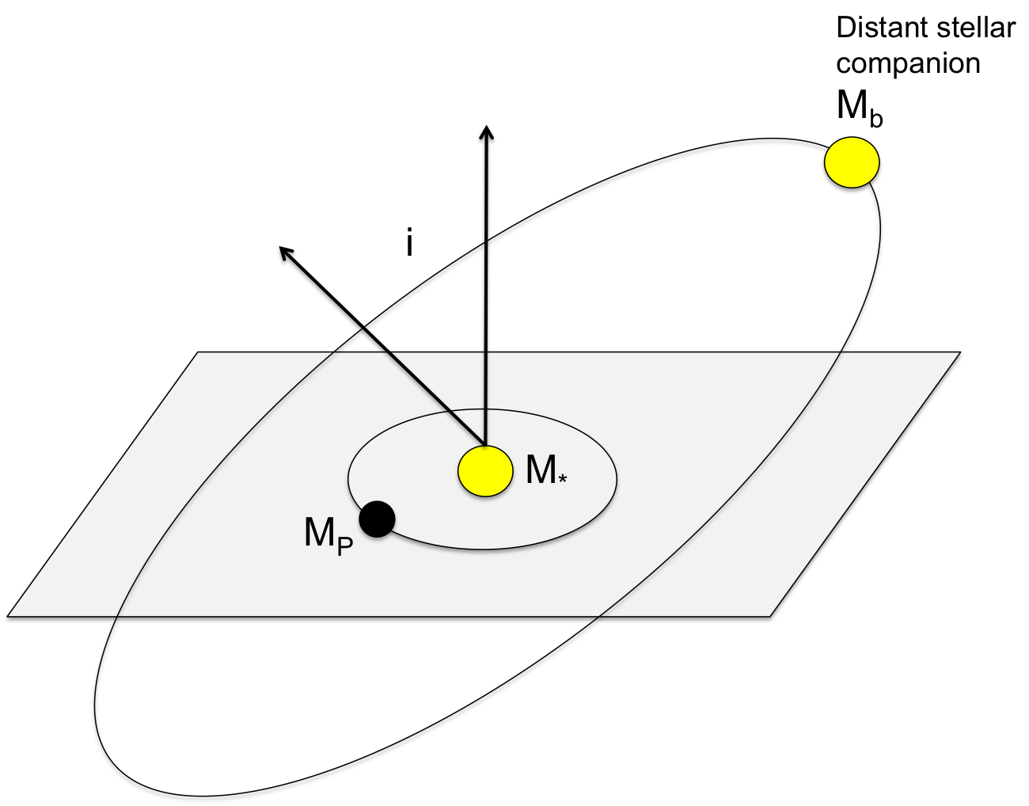
A distant (~100 AU) binary companion (M_{b}) of the planet-hosting star (M*) can
change the eccentricity (e) and inclination (I, the angle between L and the binary axis
L_{b}) of the planet (M_{p}) in a periodic way -- This is called Kozai-Lidov oscillation
L
L_{b}
I

Slide 4
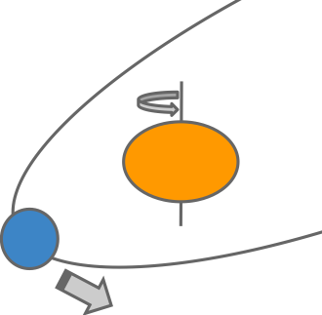
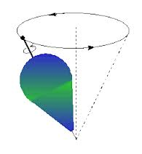
Stellar Spin Dance
The host star is spinning, and therefore has an oblate shape.
Gravity from the planet acting on the oblate star makes S (the rotation axis of the star) precess around L (the orbital axis of the planet).
L
S
This is analogous to the precession of
a spinning top due to Earth’s gravity

Slide 5
Stellar Spin Dance
The host star is spinning, and therefore has an oblate shape.
Gravity from the planet acting on the oblate star makes S (the rotation axis of the star) precess around L (the orbital axis of the planet).
L
S
However, recall that L itself is changing
due to the gravity from the distant binary
companion
L
L_{b}
I

Slide 6
Spin-Orbit Evolution
So we have:
L moves around L_{B} (the orbital
axis of the binary, which is not
changing) at frequency Ω_{pl}
S moves around L
at frequency Ω_{ps}
Ω_{pl}
L_{B}
Ω_{ps}
L
S
θ_{sl}
θ_{lb}
θ_{sb}
This coupled motion of S and L gives
rise to complex (even chaotic) evolution of
the star’s spin axis and the spin-orbit angle

Slide 7
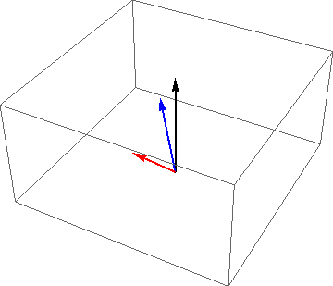

For Ω_{pl} much larger than Ω_{ps}:
L_{B}
L
S

Slide 8
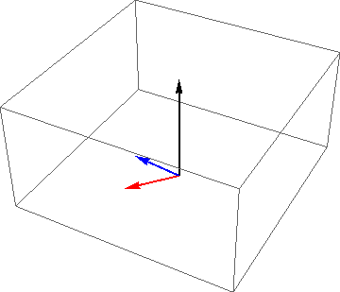

For Ω_{pl} much smaller than Ω_{ps}:
L_{B}
L
S

Slide 9
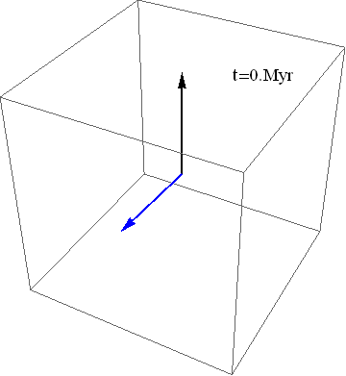

For Ω_{pl} comparable to Ω_{ps}:
L_{B}
L
S

Slide 10
Evolution of Stellar Spin and Planetary Orbit
We see that the spin-orbit angle (bottom panel) evolves erratically even
when the planet’s orbital eccentricity evolves regularly. In fact, the spin
evolution can be chaotic: starting from almost the same initial condition,
the spin-orbit angles quickly diverge.

Slide 11
Periodic Islands in a Chaotic Ocean
Spin-orbit angle
Planet mass

Slide 12
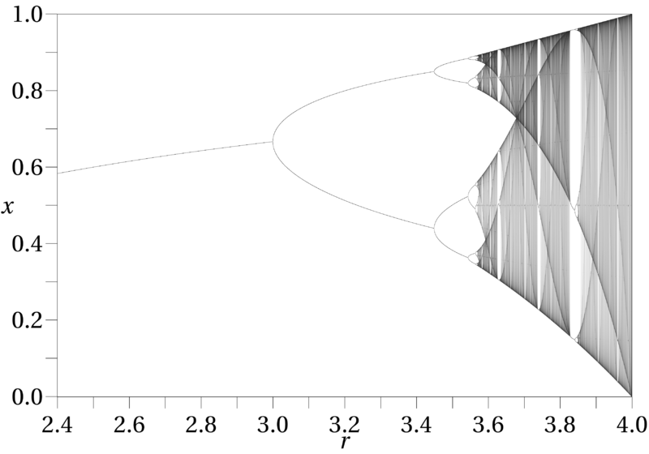
Periodic Islands in a Chaotic Ocean
This is analogous to the logistic map:
From wikipedia

Slide 13
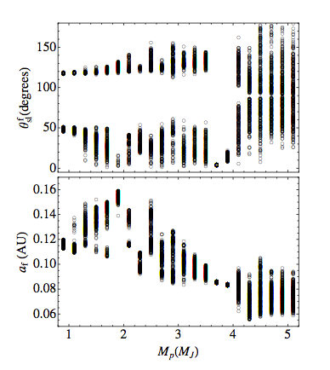
Memory of Chaos
A tiny spread in initial conditions can lead to a large spread in the final spin-orbit misalignment

Slide 14
The complex spin evolution can affect the observed distribution of the spin-orbit misalignment angle of hot Jupiter systems.

